Slide 1

Okan Davut | Senior Frontend Developer
MICRO-FRONTEND ARCHITECTURE
with PIRAL

Slide 2

Agenda
1
Who am I?
2
Micro-Frontend Architecture
3
Why Micro-Frontend Architecture
4
Introduction to the Piral
5
Piral Architecture
6
Advantages and Disadvantages of Piral
7
Thanks & Questions

Slide 3

Who am I ?
Okan Davut
Senior Frontend Developer @adessoTurkey
MSc. Computer Engineering & BSc. Software Engineering
Worked multinational companies and different industries
Like to live different experiences
Like to share experiences with people
Runner, Youtuber and Traveler

Slide 4
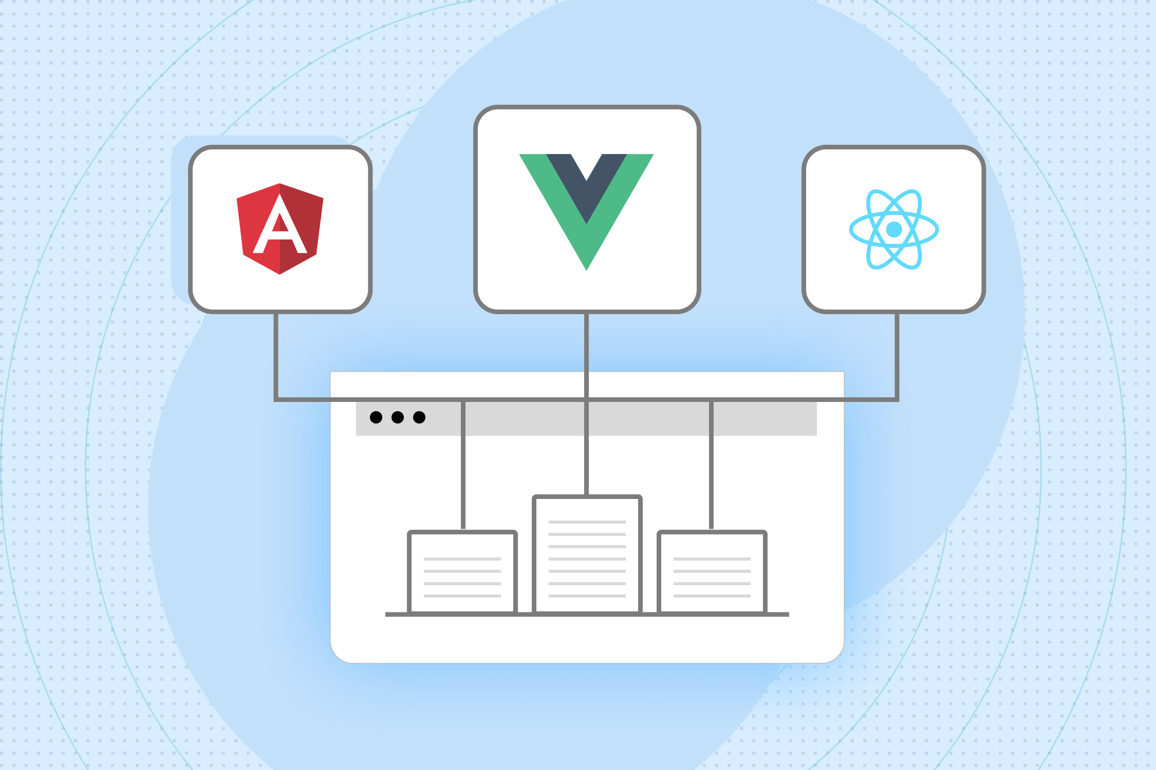
Micro-frontend architecture
Micro-frontend architecture is a design approach where a web application's user interface is divided into smaller, independently deployable components, each owned by different teams.
This allows for simultaneous development and updates across various parts of the application, enhancing scalability and flexibility.
It mirrors the principles of microservices, but applied to frontend development, promoting technological diversity and modularization.

Slide 5
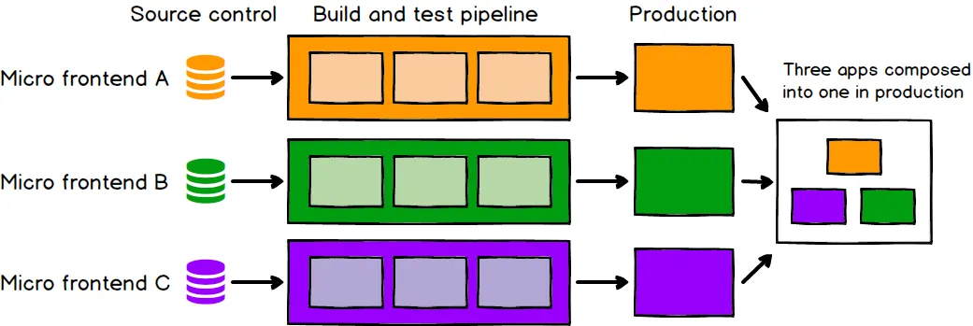
Why Micro-Frontend Architecture
Multiple teams to work in parallel
Reducing bottlenecks and speeding up feature development.
Enhances scalability and allows for the use of diverse technologies
Simplifies updates and maintenance, as changes to one micro-frontend can be made without impacting others.
Ensuring a more agile and flexible development process.

Slide 6


Slide 7

Introduction to the Piral
Piral is a framework for creating modular micro-frontend architectures.
Allowing teams to build and manage independent modules that are combined into a cohesive user interface.
Piral focuses on ease of integration, flexibility, and boosting developer productivity in complex frontend landscapes.

Slide 8
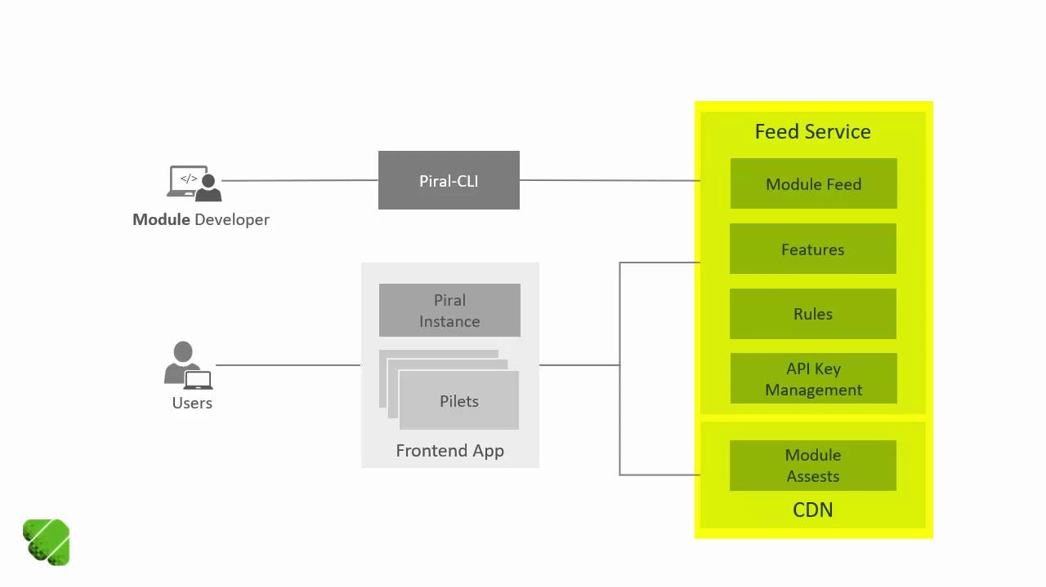
piral architecture
App Shell: Foundation of a Piral application, responsible for integrating various micro-frontends and managing the layout and routing.
Pilet: Individual micro-frontend or a module within the Piral ecosystem.
Feed Service: Facilitates dynamic loading and updating of pilets, enabling real-time integration and management of these micro-frontends across the application.

Slide 9
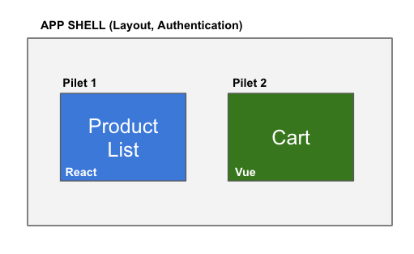
Piral Architecture - example

Slide 10
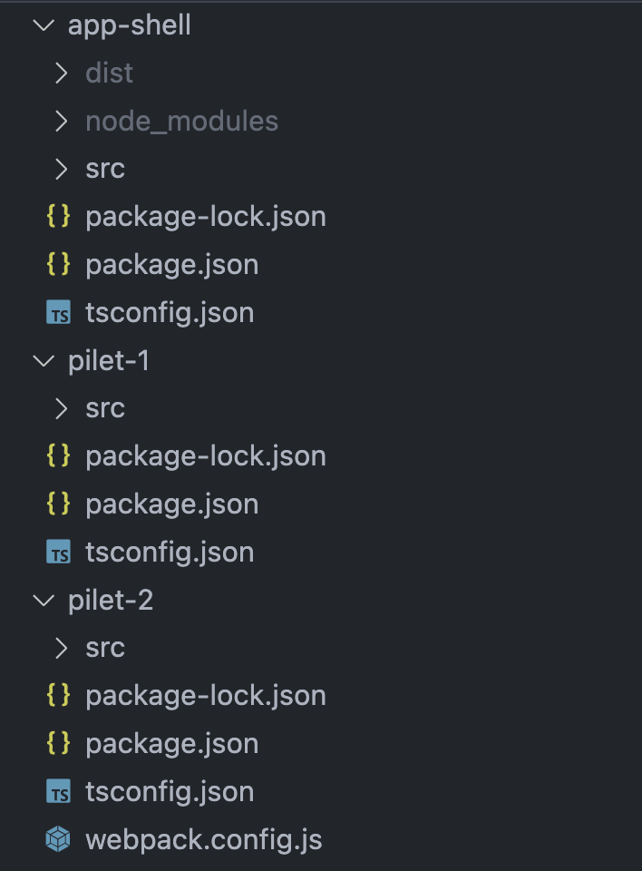
App structure
app-shell - main application layout
Register applications
pilet-1 - React application
Product page
Product card
pilet-2 - Vue application
Cart
Buy Button

Slide 11
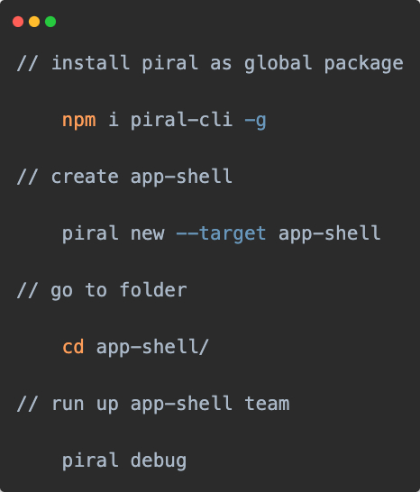
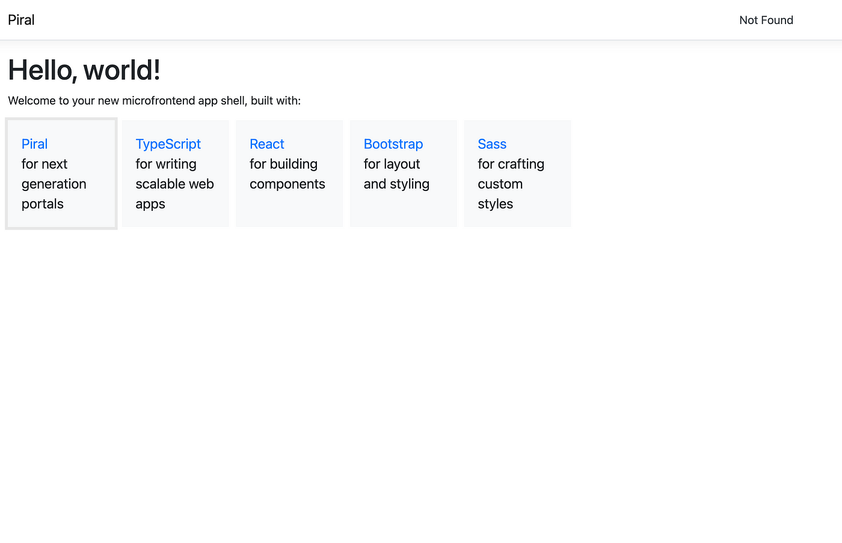
App-shell

Slide 12
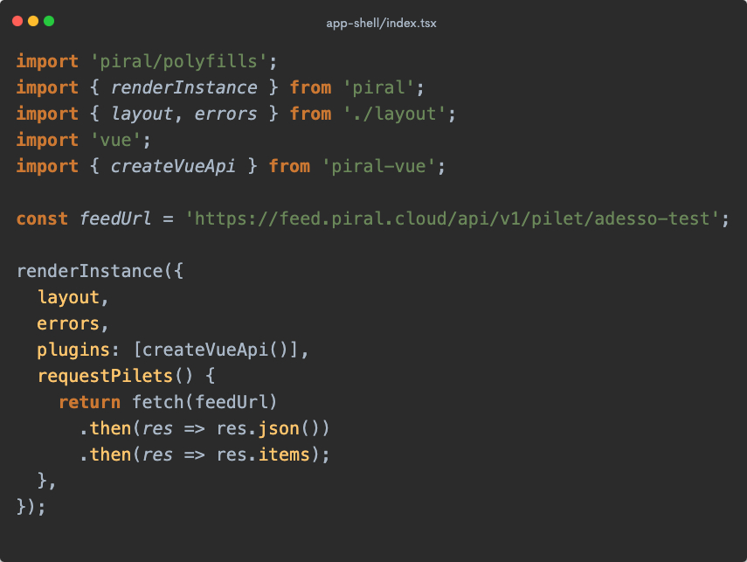
App shell
Piral package
Piral-vue
feedUrl
renderInstance
Layout
Plugins
requestPilets from feedUrl

Slide 13
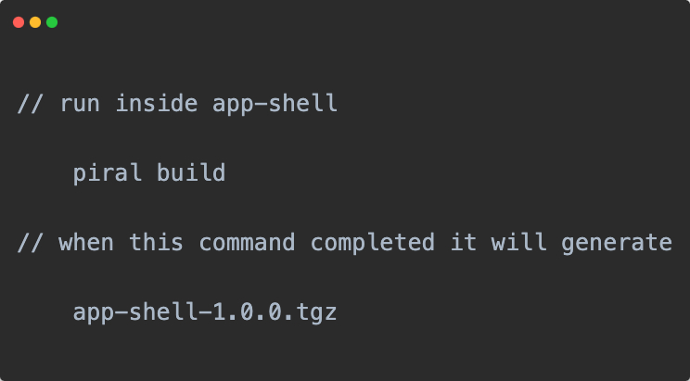
After completing the coding of app-shell

Slide 14
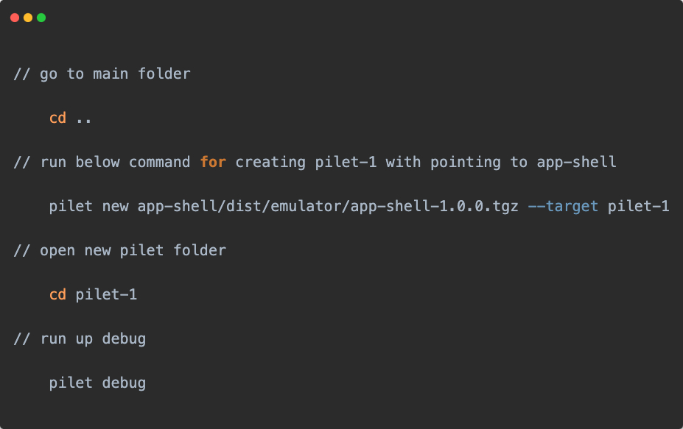
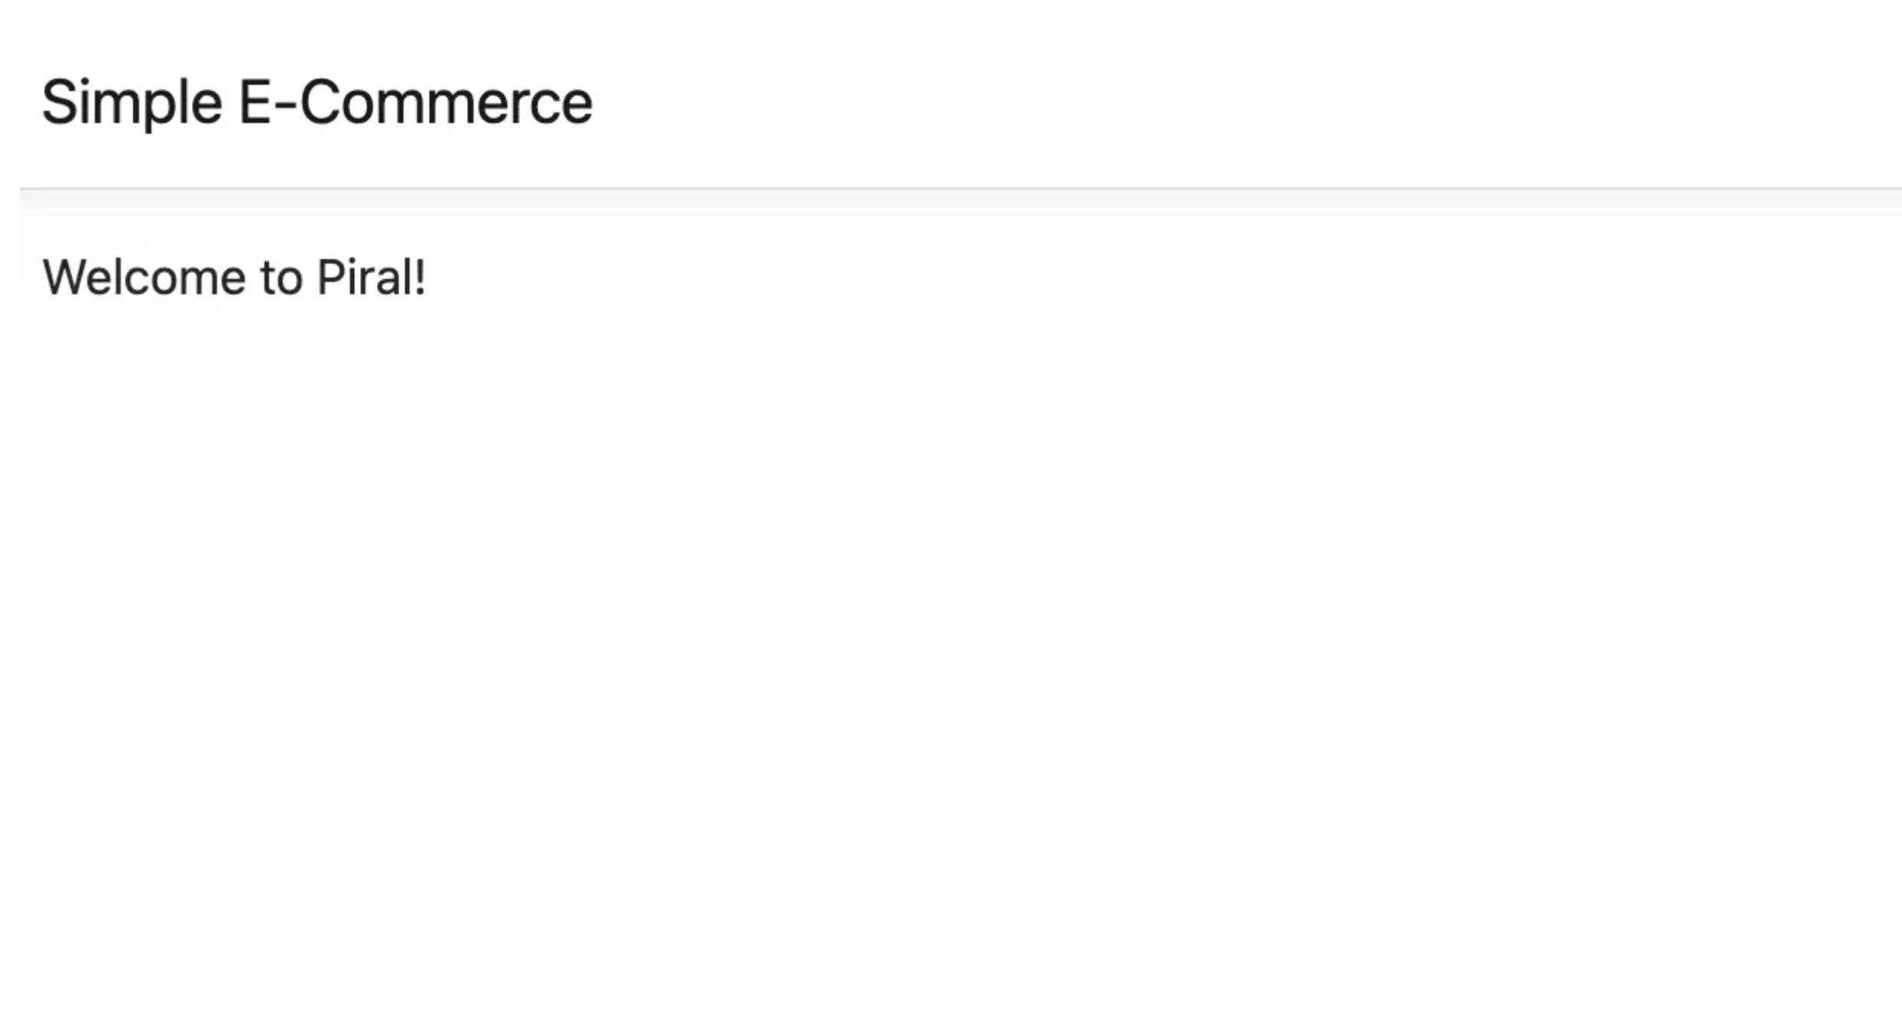
Creating pilets

Slide 15
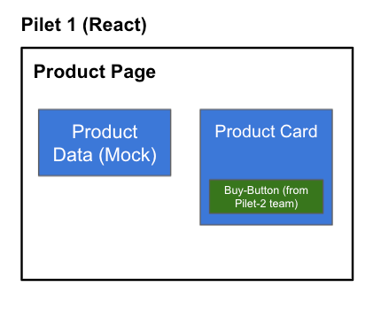
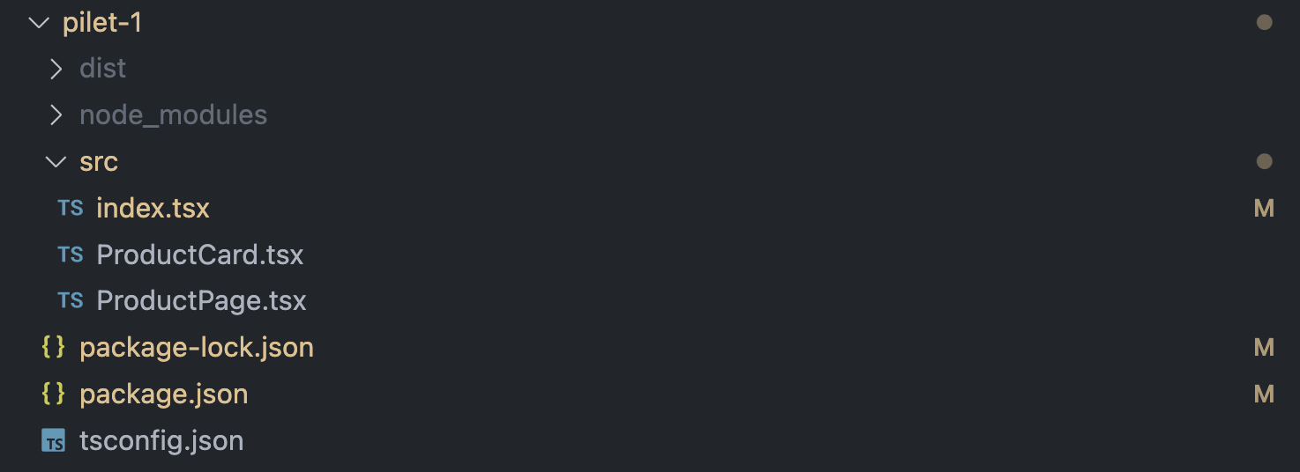
Pilet - 1

Slide 16
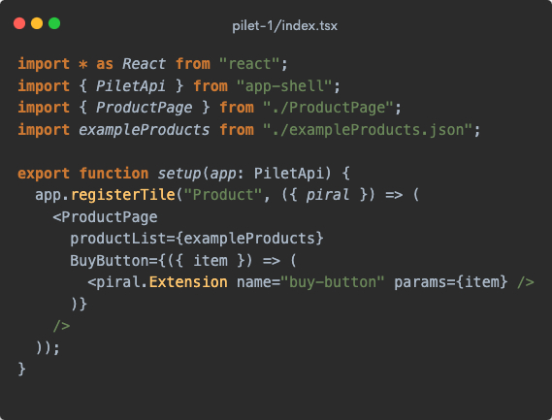
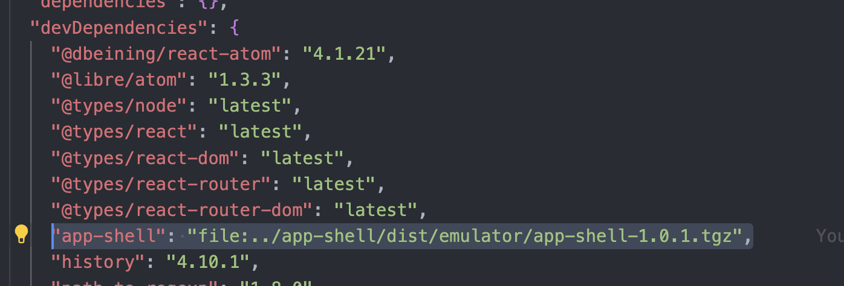
Pilet 1 – setup
app-shell local npm package
registerTile
Piral.Extension

Slide 17
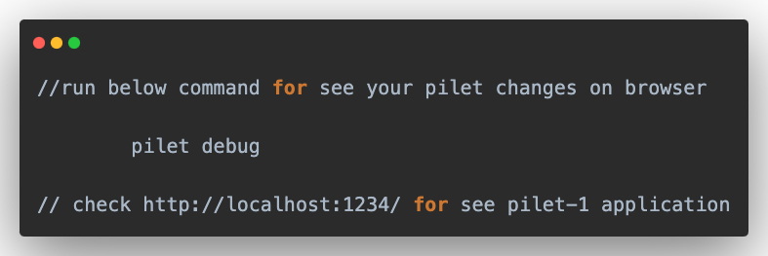
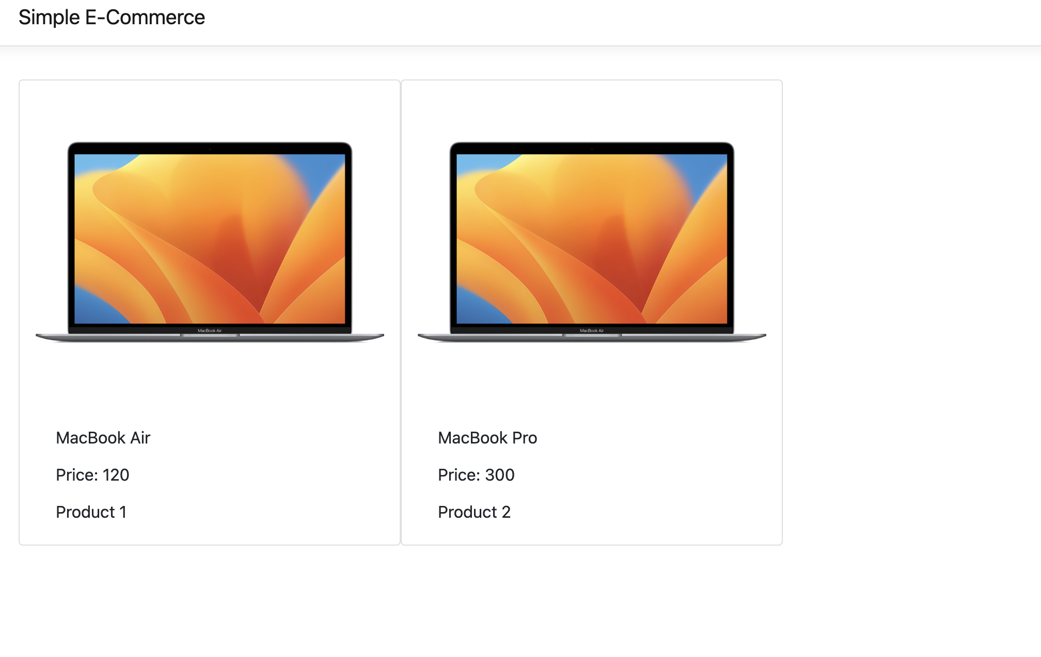
Pilet-1 preview

Slide 18
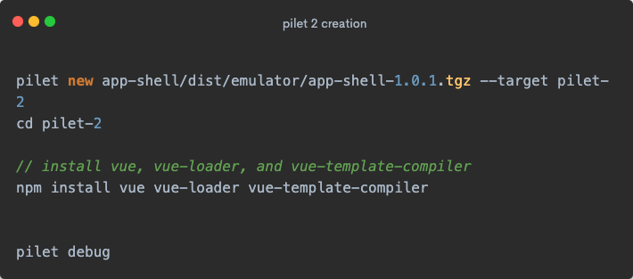
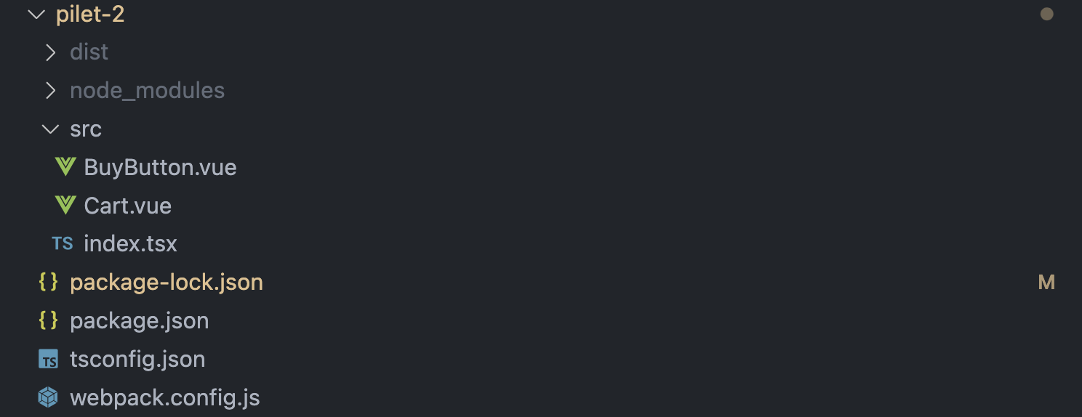
Pilet - 2

Slide 19
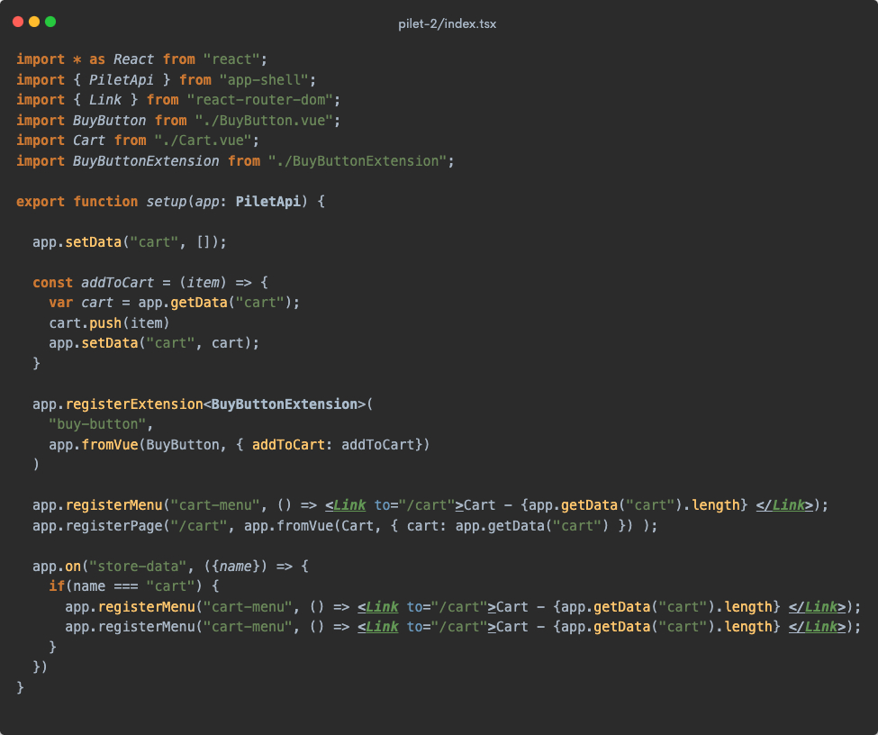
Pilet-2 - setup
App.setData - app.getData
App.registerExtension
App.registerMenu
App.registerPage

Slide 20
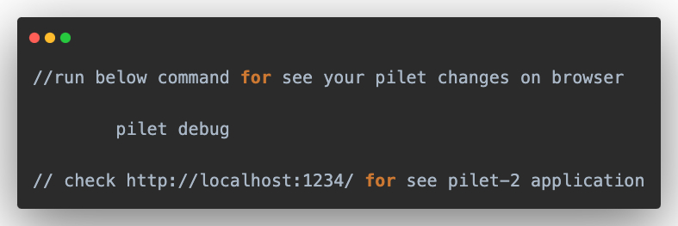
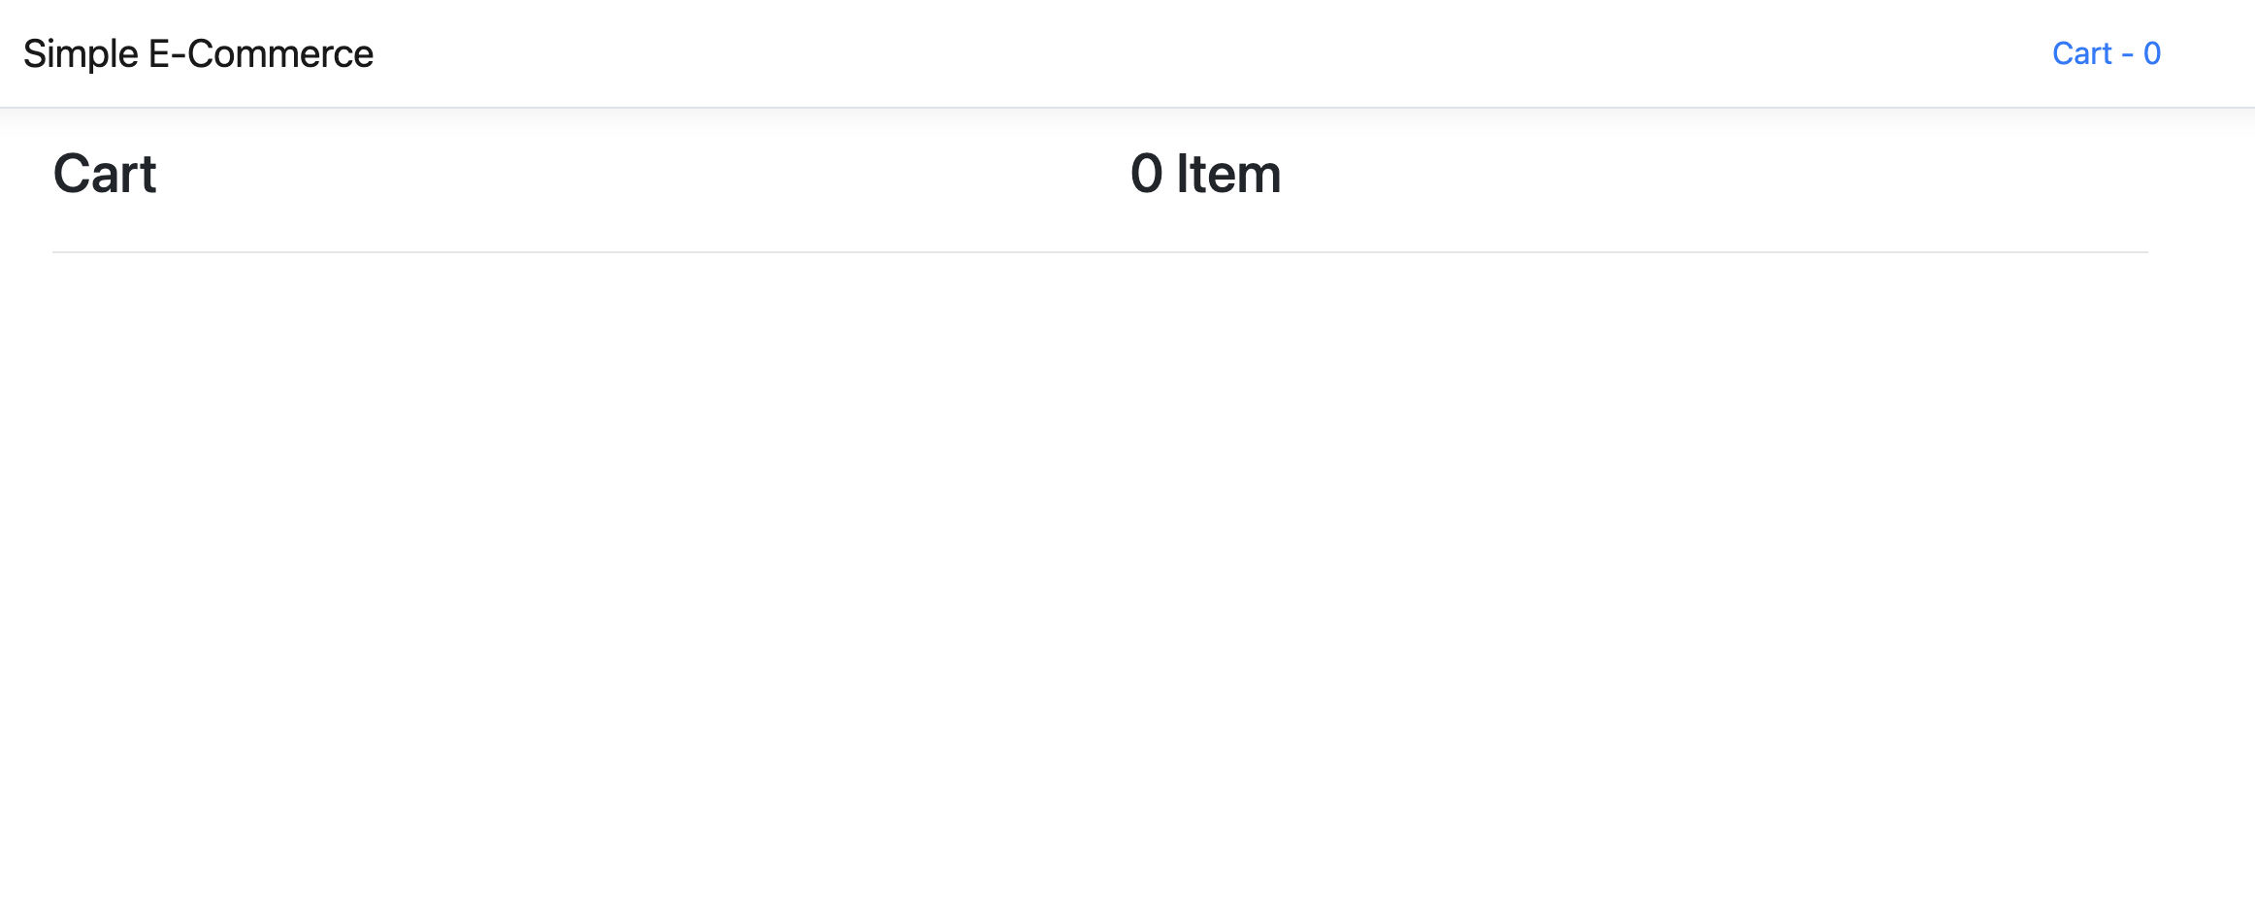
Pilet-2 preview

Slide 21
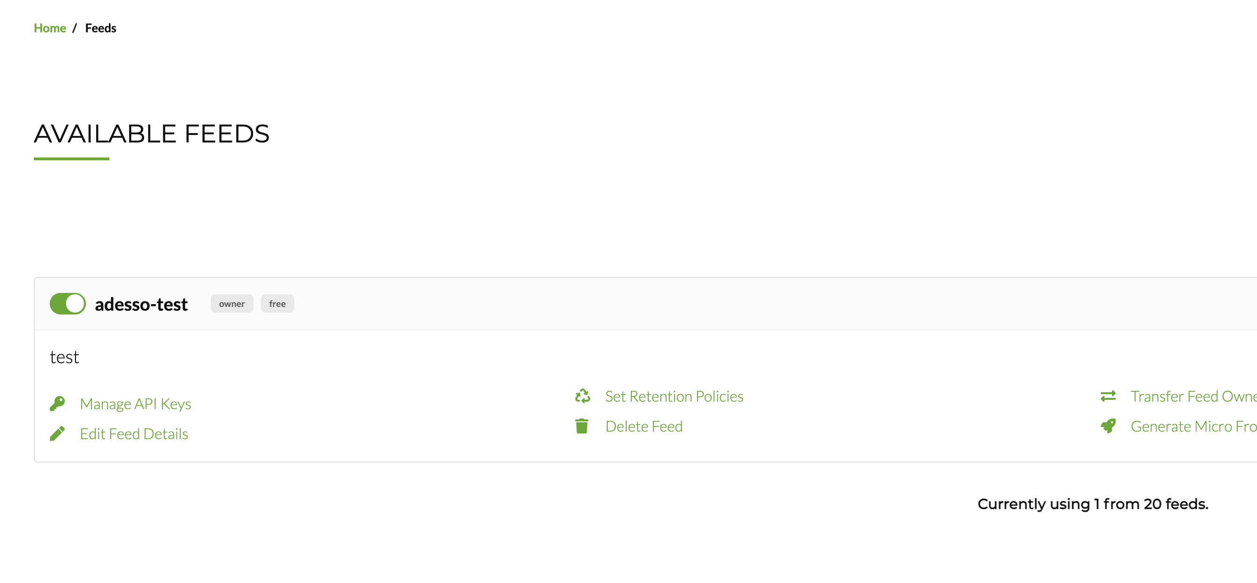
Deployment of the applications
Create feed service using Piral Cloud
https://portal.piral.cloud/feeds
Deploy your own server

Slide 22
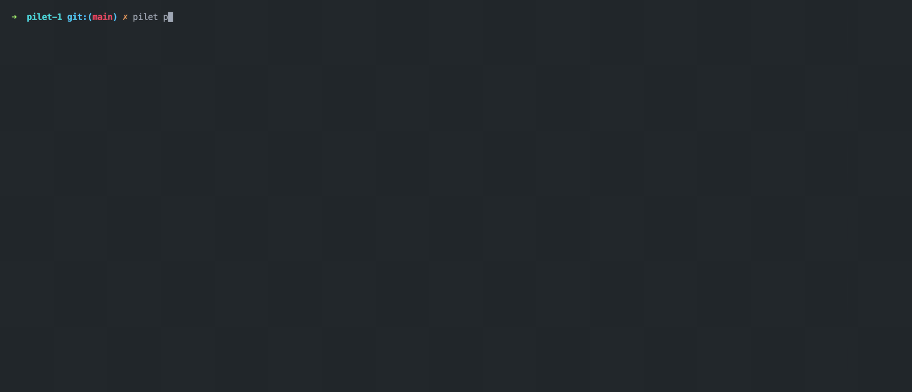
Publishing the PILETS

Slide 23
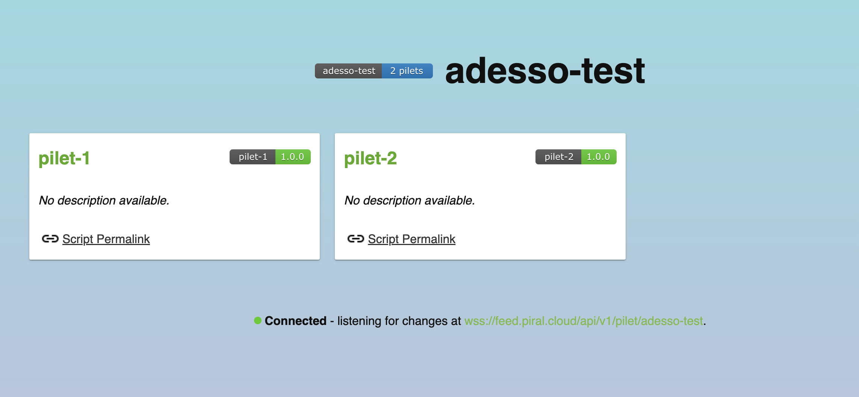
Publishing the PILETS

Slide 24
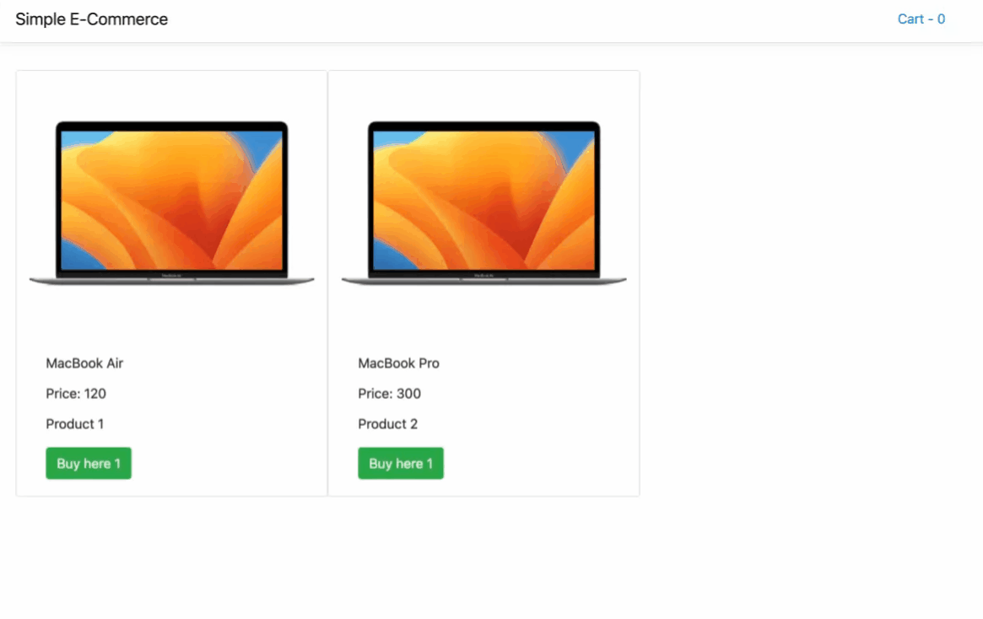

Slide 25

ADVANTAGES of using piral
Plugin System: Simplifies extension and customization of applications.
Framework Agnostic: Supports different frameworks within the same app, promoting flexibility.
Reusable Components: Facilitates the creation and sharing of reusable components.
Scalability: Supports scalable application development with independent deployments.

Slide 26

DISADVANTAGES of using piral
Complexity: Adds complexity due to its architecture and multiple integrations.
Learning Curve: Requires learning specific Piral concepts and approaches.
Specific Architecture Requirements: Piral imposes specific architectural patterns and structures, which may not align with all project requirements or existing development practices.
Limited Community and Resources: Piral has a smaller community and fewer resources, which can impact problem-solving and support.

Slide 27

Bonus: monolithic or micro-frontend

Slide 28
Okan Davut | Senior Frontend Developer
Many thanks!
Questıons?
Twitter: @okandavutcom
LinkedIn: Okan Davut
E-mail: davut.okan@gmail.com

